Slide 1
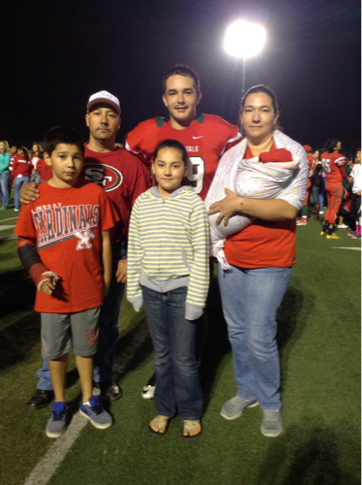
Noel D. Ibarra

Slide 2
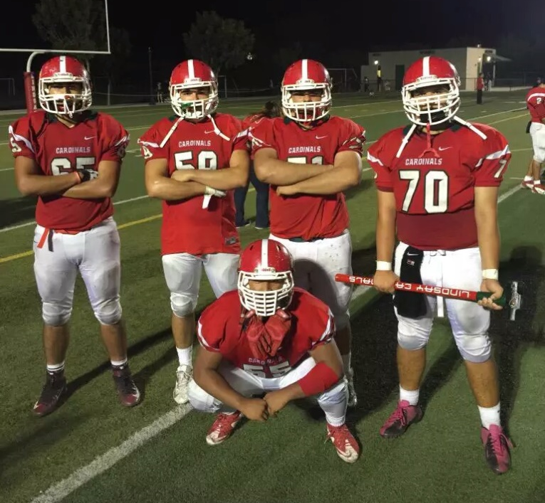
About me
3 siblings
I love watching football
First language Spanish
First one in my family to graduate
Private, shy person

Slide 3
High school Experience
Activities
Played football for 3 years
Red zone
FFA
I learned that everything is about trying
Set goals and work hard
Things I learned about myself
That I can do anything I want by trying hard enough
I am actually smart if I try

Slide 4
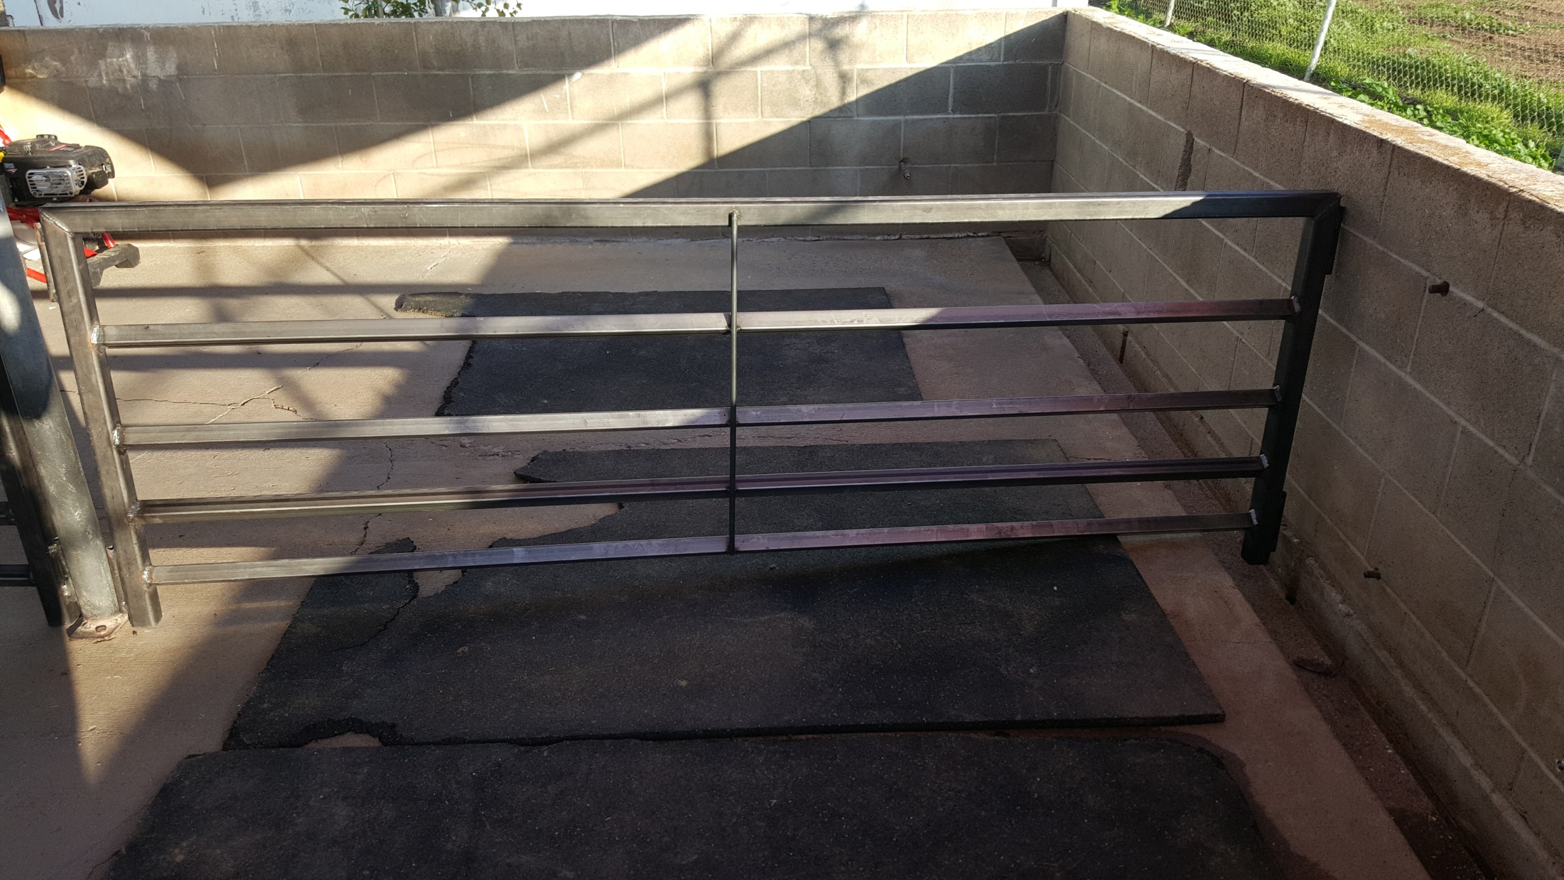
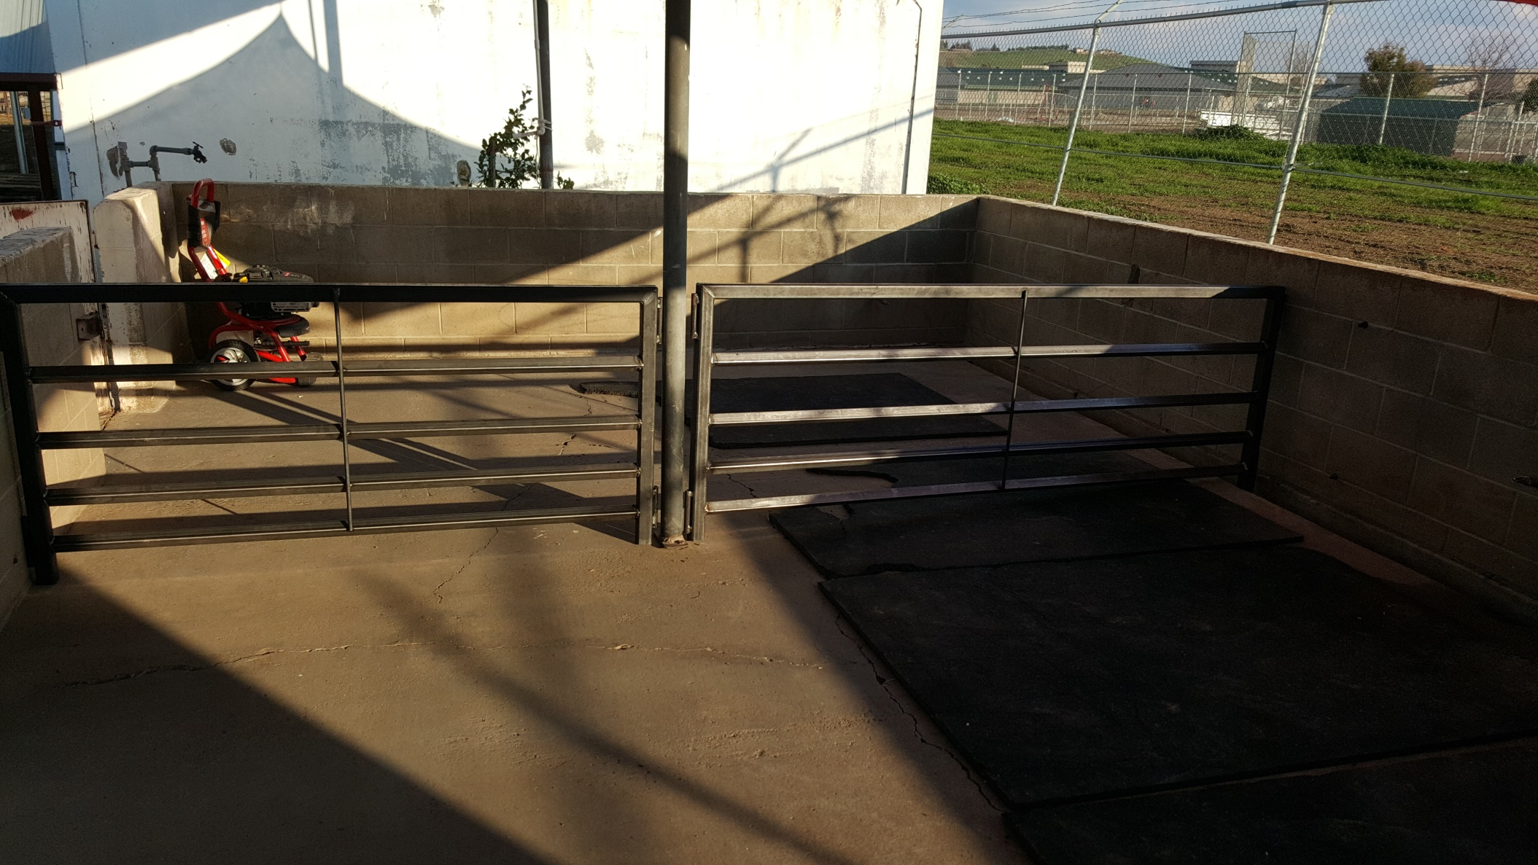
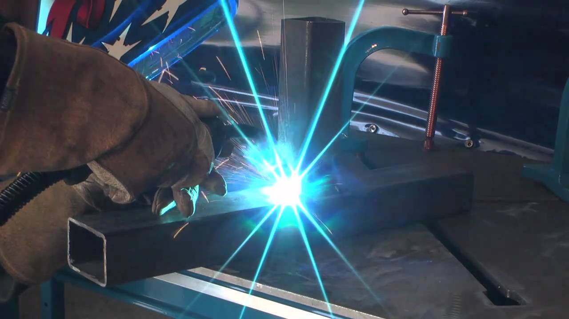
Pathway
Ag mechanics
welding
Hand on experience
Different from my job shadow but interested in a Agricultural job.

Slide 5
Job shadow
Highway patrol (CHP)
Don’t see myself doing this
Dangerous
Too much writing

Slide 6
Post high school plans
Going to college
COS
welding
Applied to COS back in November of last year
My family supports me in anything I do
Work (don’t know where yet)

Slide 7
Leaving LHS
Going to miss friends and teachers
Will come back and visit LHS
Performance base system (PBS)
teachers would help me catch up
As a student we had a lot of opportunities
let me work in my own pace
Only district

